Slide 1
Skin Cancer Insights Dashboard
Data-Driven Analysis of Lesion and Patient Attributes
Prepared by: Insight Nation
Date: July 2025

Slide 2
The Team
Temitope Oluwatosin Egbaiyelo
Josephine Ijoni
Enoch Narteh-Kofi
Olusegun Kappo
Oluwabukola Adeyelu
Tolulope Olowomofe
Oluyemi Julius Ogundele

Slide 3
Problem Statement
Skin cancer detection is often delayed due to:
• Misdiagnosis
• Limited access to dermatologists
• Poor understanding of environmental risk factors
This project explores 1,088 lesion cases to identify key patterns linking demographics, exposure, and lesion traits to skin cancer types.
Goal: Improve early detection and support ML-based diagnosis systems.

Slide 4
Dashboard Overview
This dashboard visualizes SQL-extracted insights including:
• Skin cancer rates by gender, smoking, and drinking habits
• Malignancy trends by lesion region and size
• Cancer case distribution by lesion type and age group
These insights guide strategic decisions on screening, prevention, and modeling.

Slide 5
Gender vs. Skin Cancer
• Males represent 49% of skin cancer cases, slightly higher than females (51%).
• Indicates near-equal distribution; gender alone is not a strong differentiator.
• Suggests universal screening efforts should not exclude either gender.

Slide 6
Lesion Region vs. Malignancy Rate
• Highest malignancy rates found in lesions located on lips, nose, and neck.
• Suggests regions with high sun exposure are at greater risk.
• Recommendation: Prioritize UV-protected awareness and early screening for facial lesions.

Slide 7
Smoking and Drinking vs. Cancer Rate
• Smokers and drinkers exhibit significantly higher cancer rates.
• Smoking: Over 53% malignant cases in smokers vs. 23% in non-smokers.
• Drinking: Similarly elevated cancer rates.
• Recommendation: Integrate lifestyle history into diagnostic decision systems.

Slide 8
Lesion Type vs. Skin Cancer Cases
• BCC (Basal Cell Carcinoma) and ACK (Actinic Keratosis) are the most common types.
• MEL (Melanoma), though less frequent, is more dangerous and requires attention.
• Use lesion type to triage cases and guide biopsy decisions.

Slide 9
Age Group Most Affected by Skin Cancer
• Majority of cases occur in patients aged 50–79.
• Sharp drop in cases under age 40.
• Recommendation: Focus preventive screenings on middle-aged and older adults.

Slide 10
Lesion Size vs. Malignancy Rate
• Malignancy rates are directly proportional to lesion sizes:
- Small (<5mm): 8%
- Medium (5–9mm): 37%
- Large (10mm+): 55%
With large lesions accounting for more malignancy rate.
• Recommendation: early diagnosis can prevent aggravation of symptoms (lesion sizes) Therefore, monitor all size categories.

Slide 11
Strategic Recommendations
1. Target public health campaigns to older adults and high UV regions.
2. Incorporate lifestyle factors (smoking, alcohol) into diagnostic tools.
3. Train ML models using the most predictive lesion and demographic attributes.
4. Educate general practitioners on identifying high-risk lesion locations.
5. Monitor all lesions regardless of size.

Slide 12
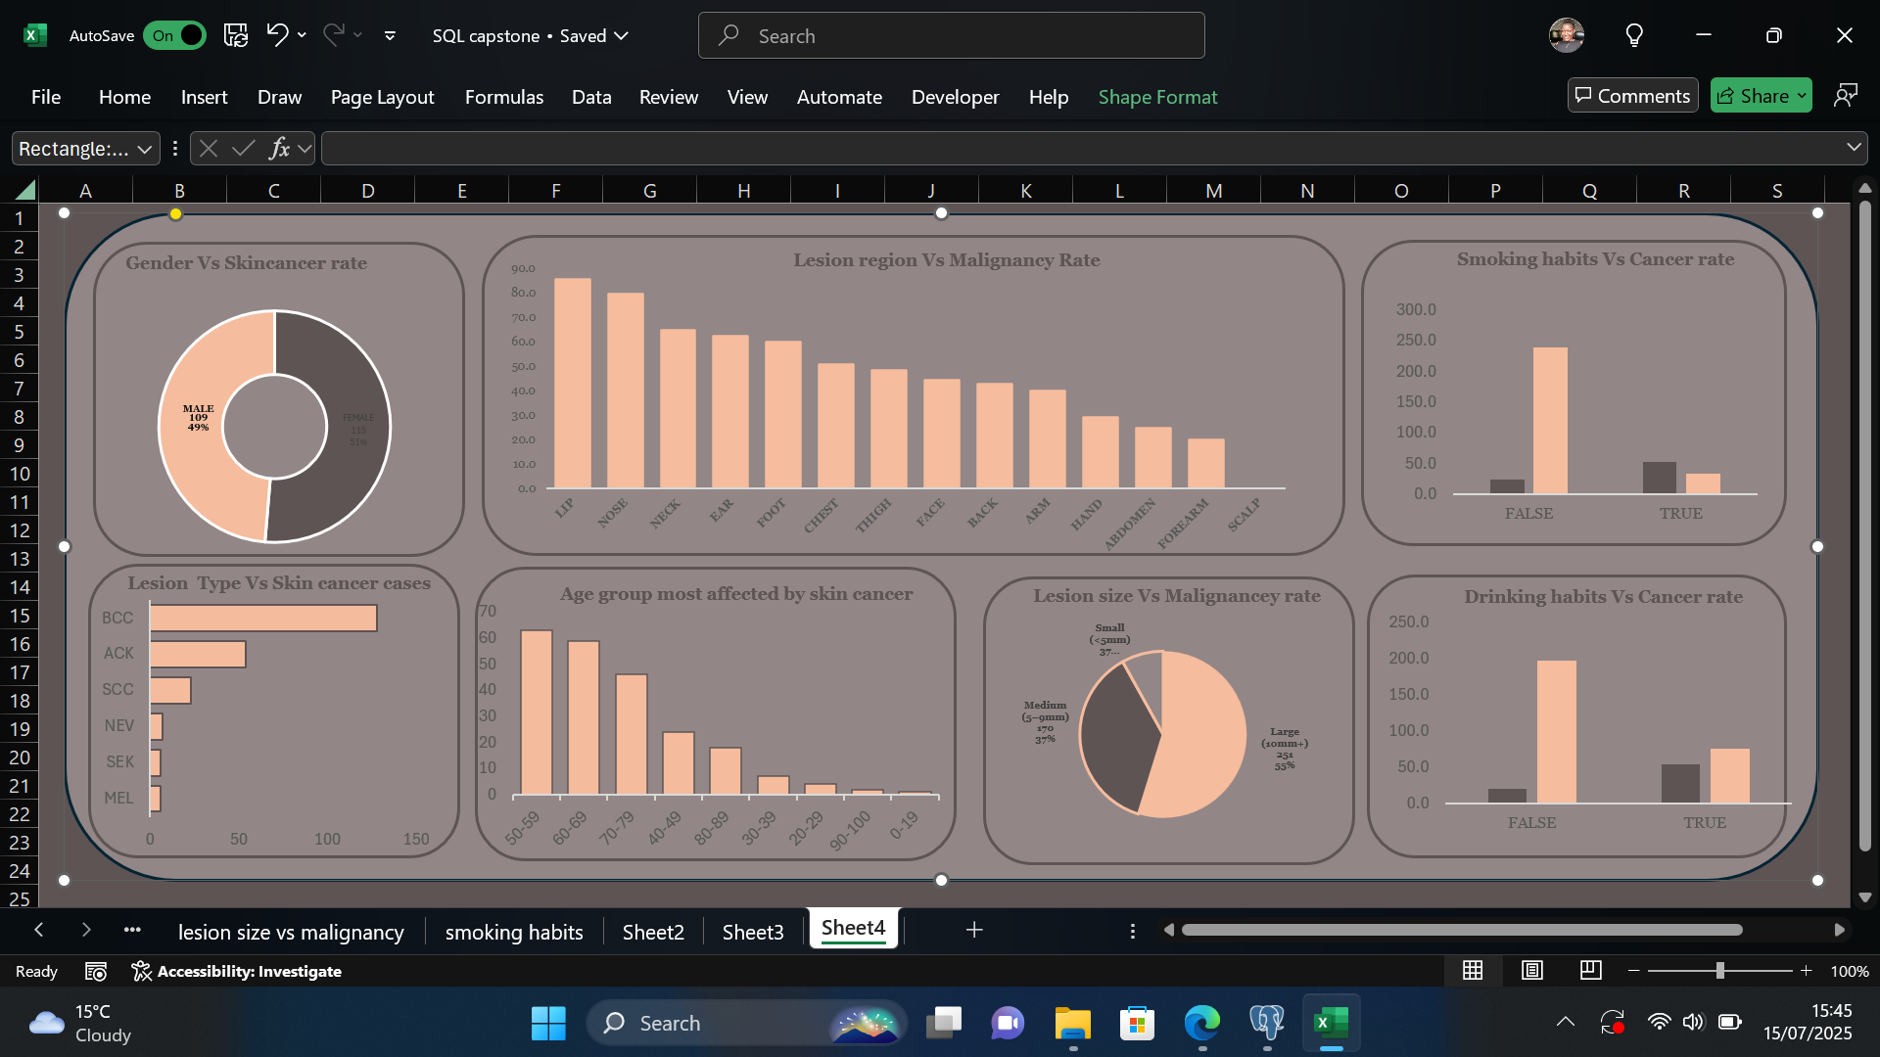

Slide 13
Thank You

